Slide 1

चरैवेति, चरैवेति
Keep progressing to attain a higher self.
avinash.bhagat@lpu.co.in Avinash Bhagat 9463281930

Slide 2
CAP275: Data Communication and Networking
Lecture # 12
Networking Devices
avinash.bhagat@lpu.co.in Avinash Bhagat 9463281930

Slide 3
What are networking Devices?
Network devices are the devices used for
      organizing a network,
      connecting to a network,
      routing the packets,
      strengthening the signals,
      communicating with others,
      surfing the web,
      sharing files on the network and many more uses.

Slide 4
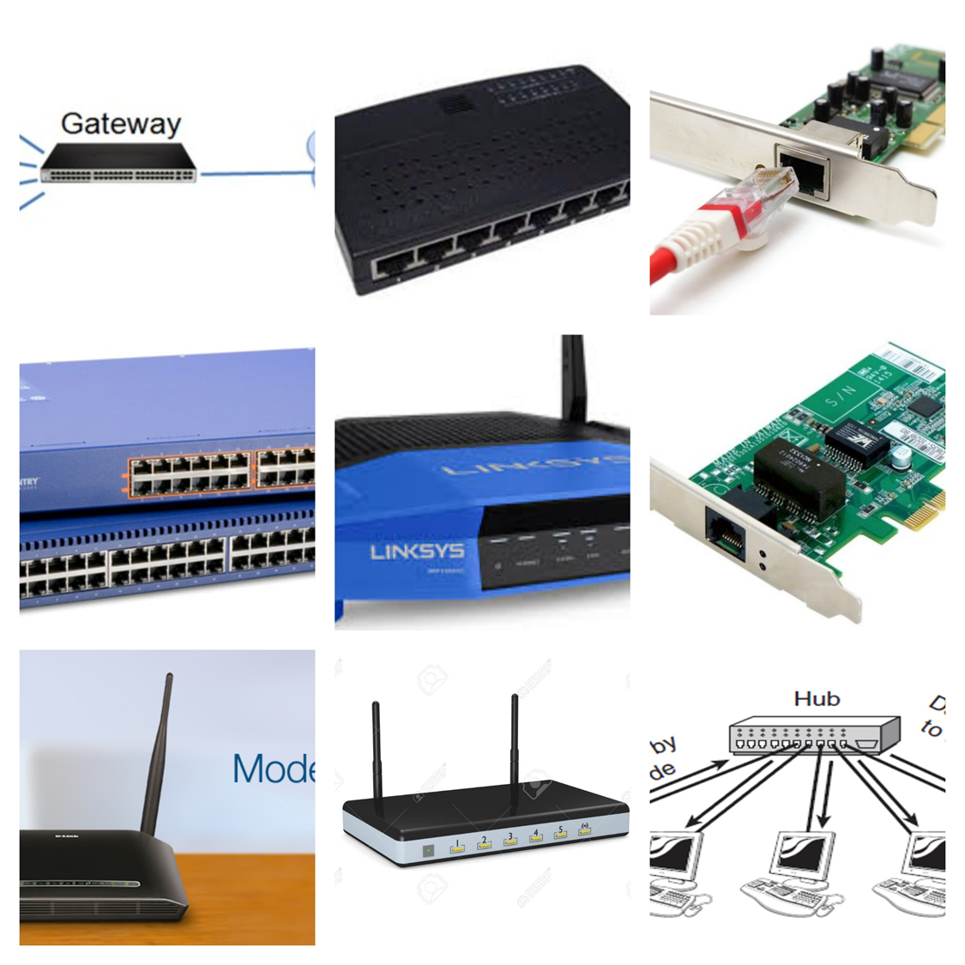
Types of network devices
Modem
Hub
Switch
NIC
Repeater
Bridge
Router
Gateway

Slide 5
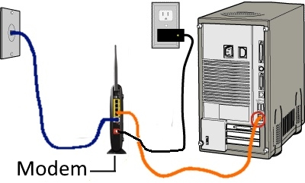
Modem
MODEM-
modulator-demodulator
Device that converts data from a digital format, into one suitable for a transmission medium such as telephone lines or radio.
Notes:
A modulator-demodulator, or simply a modem, is a hardware device that converts data from a digital format, intended for communication directly between devices with specialized wiring, into one suitable for a transmission medium such as telephone lines or radio.
Speed of modem is measured in bits per second and varies depending upon the type of modem. Higher the speed, the faster you can send and receive data over the network.
Used to connect computer to the internet.
Layer -1

Slide 6
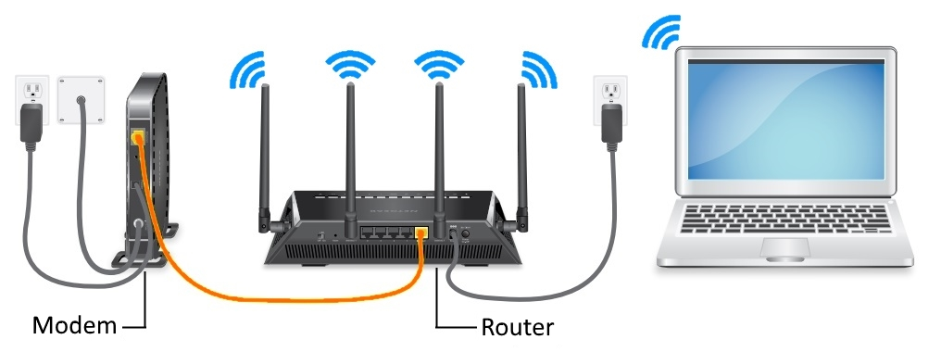
MODEM
Types
DSL modems that use a common telephone "cord" as a source.
Wired modems connected via a direct connection to the Internet cable.
Wireless modems using the mobile network signal: 3G, 4G, and so on.
Notes:
Consider a communication between two computers A and B.
Computer A transmits the digital signals to its modem in the form of binary 0's and 1's.
Modem of computer A converts these digital signals it into analog signals and sends over the telephone line. This process is called as modulator.
While at the other end, modem of computer B receives the analog signals and converts back into digital signals. This process is called as demodulator.
Converted digital signals by the modem are sent to the computer B for processing.
In similar way computer B can communicate with computer A.

Slide 7
Hub
Layer -1
2,4,8 port hub
Half duplex
Can not store MAC Address (dumb device) Do not manage any table.
Always Broadcast
LAN Device
Single collision domain
Active and Passive Hubs
Notes:
When referring to a network, a hub is the most basic networking device that connects multiple computers or other network devices together. Unlike a network switch or router, a network hub has no routing tables or intelligence on where to send information and broadcasts all network data across each connection.
Name from Wheel center called HUB
the central part of a wheel, rotating on or with the axle, and from which the spokes radiate.
Active hub require power and amplify signals. Passive hub simply repeats signals.

Slide 8
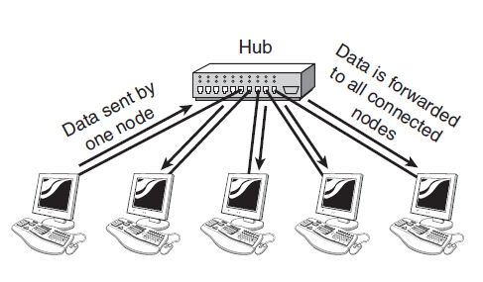
Working of HUB

Slide 9
Repeater
Repeater is a electronic device that reshapes and amplifies the signal received from one LAN segment to another.
It Is like active hub
Layer 1 device
e.g. 10Base2 - 185m

Slide 10
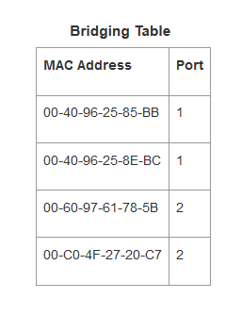
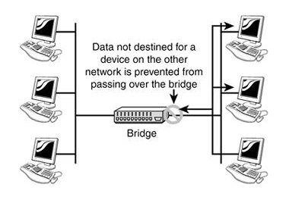
Bridge
Bridge is a networking device that connects two or more LAN's segments together.
Operates at data link layer of OSI model.
Filter Data Traffic : Inspect incoming traffic and forward it or rejects it by checking MAC address.
It has two collision domains.
Maintains a Bridge Table
Notes:
Can transfer data between two different protocols like Ethernet (802.3) and token bus (802.4).
Checks the MAC address of the frame and decides to forward the frame or to discard the frame
Definition: A bridge in a computer network is one kind of network device, used to separate a network into sections. Every section in the network represents a collision domain that has separate bandwidth. So that network performance can be improved using a bridge. In the OSI model, a bridge works at layer-2 namely the data link layer. The main function of this is to examine the incoming traffic and examine whether to filter it or forward it.

Slide 11
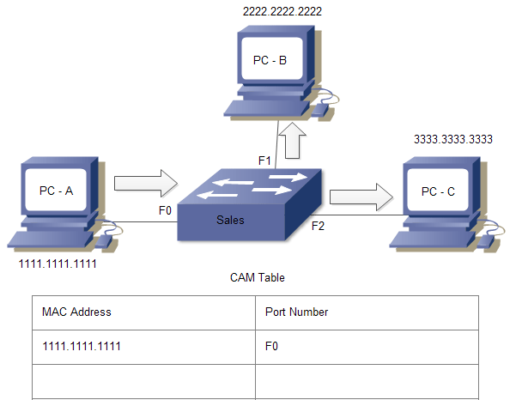
Switch (Multi port bridge)
Layer 2 Device
Every port of the switch is separate collision domain
Intelligent device Maintains Contents Accessible Memory Table (CAM)
Full Duplex Mode
First Broadcast then unicast and multicast
It has one broadcast domain
Available in 8/16/24/48 ports
Speed wireless 10mbps
Speed wired 100 mbps
Notes:
Switch is multi port bridge it consist of ASIC application-specific integrated circuit

Slide 12
Type of Switch
Store and forward switch :
the switch buffers and verifies each frame before forwarding it , it is slow but reliable. It checks errors also
Cut through Switch:
the switch read only up to the frame hardware address before forwarding it do not check error.
Fragment free switch:
a method that attempt to retain the benefits of both above it checks first 64 bytes (headers)
Adaptive switching :
a method of automatically selecting between three modes

Slide 13
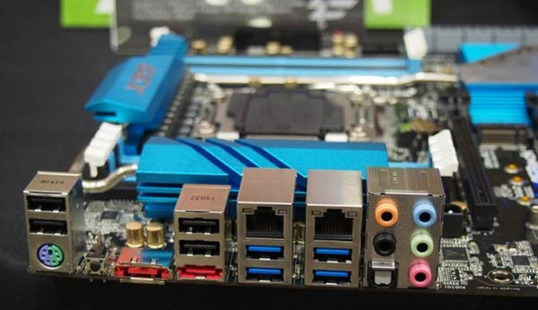
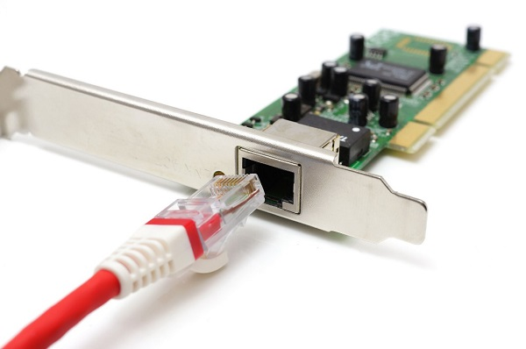
NIC
A Network Interface Card (NIC)
circuit board or a card that allows computers to communicate over a network via cables or wirelessly.
Notes:
Description
It is also called as LAN adaptor, network adaptor or network card.
Enable clients, servers, printers and other devices to transmit and receive data over the network.
Operates on physical layer (data link)
Every network adaptor is assigned a unique 48-bit Media Access Control (MAC) address, which is stored in ROM to identify themselves in a network or a LAN.
Available maximum data transfer rate is 10, 100 and 1000 MBPS.
Typically network adaptor has RJ45 or BNC or both sockets for connecting and a LED to show up it is active and transmitting the data.
Connects to a network via cables like CAT5, Co-axial, fiber-optics etc. And wirelessly by a small antenna.

Slide 14
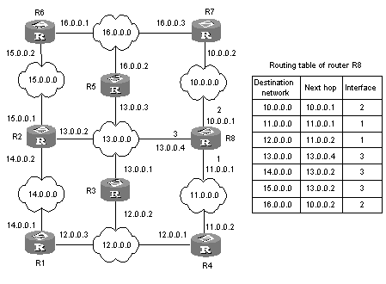
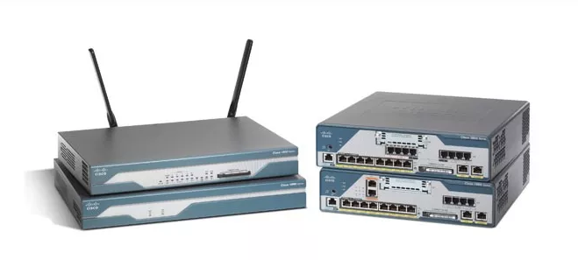
Router
Internetworking device
Layer -3 device
WAN Device
Connect two or more networks
Every port has its own broadcast domain
Uses IP addresses
Maintains a routing table
2/4/8 ports
Fast 10/100/1Gbps
Notes:
Router is internetwork connecting device that determines most efficient path for sending a data packet to any given network.
Give example of 10.10.10.5 and 10.20.20.5 example .
Used to connect two or more similar or dissimilar topological LANs or WLANs
Shares available bandwidth with multiple computers in a network.
Provides a better protection as a hardware firewall against hacking.
Routers are intelligent enough to determine shortest and fastest path from source to destination in a network using algorithms.
Operates at network layer of OSI model.
Wireless routers are now widely used in home and offices as they allow a user to connect easily without installing any cables.

Slide 15
Gateway
A gateway, as the name suggests, is a passage to connect two networks together that may work upon different networking models.
Gateways are also called protocol converters and can operate at any layer. Gateways are generally more complex than switch or router.
A router can communicate between two different network using same protocol on the other hand a gateway is a network node that connects two network using different protocols. A gateway, as the name suggests, is a passage to connect two networks

Slide 16
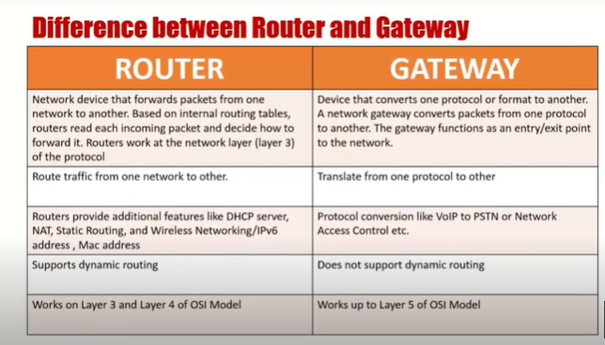
Gateway

Slide 17
Multiple Choice Questions
Modem—Layer 1
Hub—Layer 1
Switch—Layer2
NIC—Layer 1 /2
Repeater –Layer1
Bridge—Layer2
Router—Layer3
Gateway- any layers
Router is ____________ device.
Network Layer
Transport Layer
Physical Layer
Data Link Layer

Slide 18
Multiple Choice Questions
Modem—Layer 1
Hub—Layer 1
Switch—Layer2
NIC—Layer 1 \ Layer2
Repeater –Layer1
Bridge—Layer2
Router—Layer3
Gateway- all layers
Router is ____________ device.
Layer3
Layer4
Layer1
Layer2

Slide 19
Multiple Choice Questions
Device used to convert Digital signals to Analog signal. –MODEM
Device used to broadcast mechanism for communication —HUB
Device forwards the message to actual recipient in the network –switch
Device used to manage the routes between two nodes located in
different network—router
Hardware device or software application used to protect the internal network from external threats. -Firewall

Slide 20
Multiple Choice Questions
Device used to connect two network segments—Bridge
A network node equipped for interfacing with another network that uses different communication protocols--Gateway

Slide 21
Multiple Choice Questions
Which of the following is true about Gateway
  The software interface between a web-based shopping cart and a merchant account
  A webpage designed to attract visitors and search engines to a particular website
  A network node equipped for interfacing with another network that uses different communication protocols.
  All of the above

Slide 22
Multiple Choice Questions
The_________ layer is responsible for the delivery of a message from one process to another.
a. physical
b. transport
c. network
d. none of the above
The ________ address, also known as the link address, is the address of a node as defined by its LAN or WAN.
a. port
b. physical
c. logical
d. none of the above

Slide 23
References :
Text Book:
  Behrouz A. Forouzan, Data Communication and networking, 4th Ed., Tata McGraw Hills year of publication 2006
Other Specific Book:
  Andrew S. Tanenbaum,Computer Network 2nd Edition, PHI, Third Edition 1997
  Comer E. Doughlas,Computer Networks and Internets, 2nd Ed., Pearson, 2000
  W. Stallings,Data and Computer Communications, 7th Ed., Pearson, 2002.

Slide 24

See you in next class

